Slide 1

CMN 1160B – Introduction to Media Studies
Week 6A: Theoretical Perspectives on Audiences
Daniel J. Paré
University of Ottawa, Department of Communication
October 11, 2016
Notes:
1

Slide 2
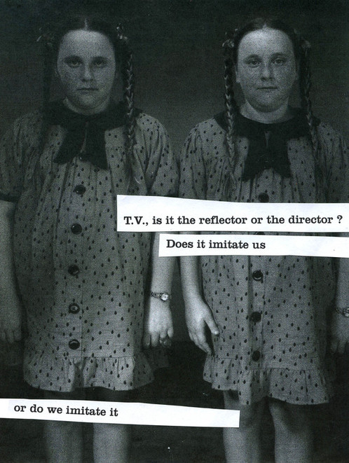
Audience Theory
2 Key Questions:
How powerful is media influence on audience behavior and ideas?
How does media shape audience perception of the world?
6 Approaches:
Effects, Agenda Setting, and Cultivation Analysis
Uses and Gratifications
Frankfurt School
Cultural Studies
Feminist Approaches
Reception Analysis

Slide 3
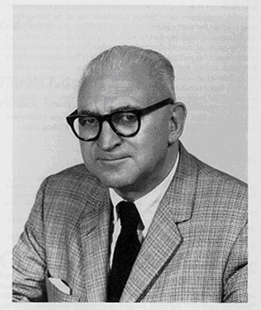
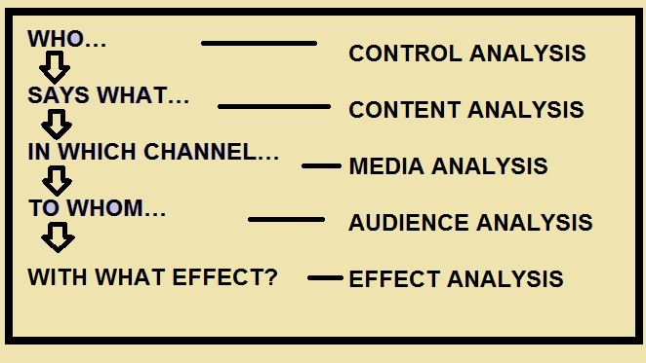
Lasswell’s Narrative Model

Slide 4

Media Effects
Notes:
4

Slide 5
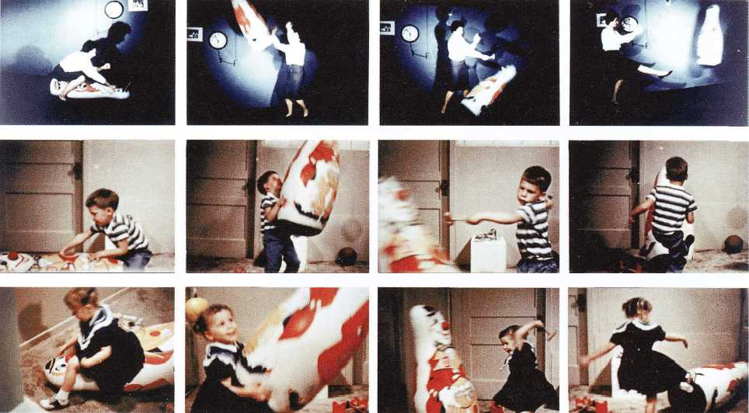
Bobo Doll Experiment
Albert Bandura 1961

Slide 6
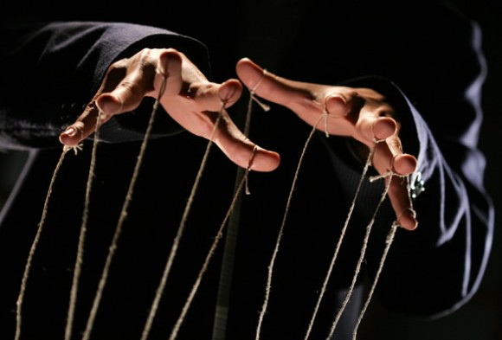
Media Effects – Agenda Setting

Slide 7

Media Effects – Cultivation Theory

Slide 8
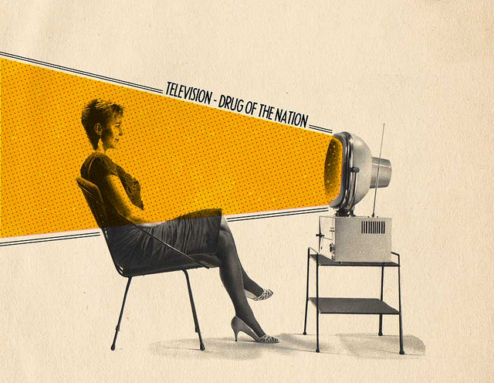
Disposable Heroes of Hiphoprisy, 1992

Slide 9
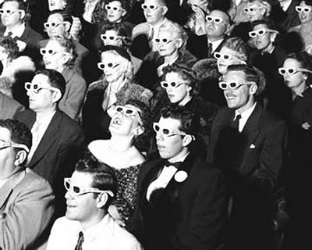
Theory of Gratifying Uses
Media is hostage to the audience because the audience is NOT passive
4 broad needs fulfilled by media:
Diversion (escape from everyday pressures);
Personal relationships (identification with characters and discussion with other people);
Personal identity (compares ones own life with characters); and
Surveillance (information about what's going on in the world).

Slide 10

Game of Thrones viewers are individuals who are motivated by different impulses
A need for company
To combat loneliness – allows audience to perceive themselves to be part of an IMAGINED COMMUNITY
The need to be part of a group
The need to identify with characters and scenarios
The need for structure and order – offers a reassuring routine
Relaxation

